Slide 1
Brown Bag - Five quick tips to improve data visualization on Stata

Slide 2
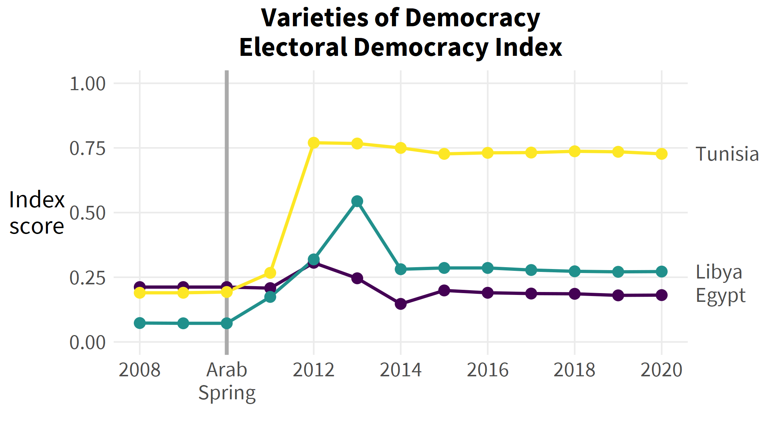
OBJECTIVE
Create graphs on STATA using data from the World Bank (democracy, governance, political stability, and inclusiveness indices) to analyze patterns and gaps on the potential implications of Arab Spring

Slide 3
Tip #1 – List the differences
How many differences between the first and second picture can you spot?
graph twoway (scatter vae year if countryname1==196) (scatter vae year if countryname1==110) (scatter vae year if countryname1==58)
Notes:
This is just going to be an induction to our TPM reports for new people – we want to get your input.
We want to have your experiences captured so that we can give this to new people who are trying to write these reports.
“We won’t have time to do week-long revisions, and if you want to do anything besides TPM, we need to get this down to a point where we don’t spend so much time on them“ – Shoot for 3 days. The edits should not be as massive as they have been.

Slide 4
Tip #2 – Focus on the big picture
Add a title
Add a legend
Change colors to something everyone can see
Connect data points
graph twoway (scatter vae year if countryname1==196, connect(direct) color(yellow)) (scatter vae year if countryname1==110, connect(direct) color(green) title("Voice and Accountability") ytitle("Index" "Score") xtitle("")) (scatter vae year if countryname1==58, connect(direct) color(purple) legend(label(1 "Tunisia") label(2 "Libya") label(3 "Egypt") col(3)))
Notes:
This is just going to be an induction to our TPM reports for new people – we want to get your input.
We want to have your experiences captured so that we can give this to new people who are trying to write these reports.
“We won’t have time to do week-long revisions, and if you want to do anything besides TPM, we need to get this down to a point where we don’t spend so much time on them“ – Shoot for 3 days. The edits should not be as massive as they have been.

Slide 5
Tip #3 – Be detail-oriented
Change the grids
Angle the y-axis values properly
Separate years properly and create a time series line plot
Orient y-axis labels horizontally
graph twoway (scatter vae year if countryname1==196, connect(direct) color(yellow)) (scatter vae year if countryname1==110, connect(direct) color(green) title("Voice and Accountability") ytitle("Index" "Score", orient(horizontal)) ylabel(,angle(0)) xtitle("") xlabel(2008(2)2020,grid) ylabel(,grid)) (scatter vae year if countryname1==58, connect(direct) color(purple) tline(2010, lc(gray)) tlabel(2010 `""Arab" "Spring""', add labsize(*.75)) legend(label(1 "Tunisia") label(2 "Libya") label(3 "Egypt") col(3)))
Notes:
This is just going to be an induction to our TPM reports for new people – we want to get your input.
We want to have your experiences captured so that we can give this to new people who are trying to write these reports.
“We won’t have time to do week-long revisions, and if you want to do anything besides TPM, we need to get this down to a point where we don’t spend so much time on them“ – Shoot for 3 days. The edits should not be as massive as they have been.

Slide 6
Tip #4 – Build & improve
Add/format legend
Add labels
Adequately label values
graph twoway (scatter vae year if countryname1==196, connect(direct) color(yellow)) (scatter vae year if countryname1==110, connect(direct) color(green) title("Voice and Accountability") ytitle("Index" "Score", orient(horizontal)) ylabel(,angle(0)) xtitle("") xlabel(2008(2)2020,grid) ylabel(,grid) text(0.4 2019.5 "Tunisia") text(-1.55 2019.5 "Libya") text(-1.30 2019.5 "Egypt")) (scatter vae year if countryname1==58, connect(direct) color(purple) tline(2010, lc(gray)) tlabel(2010 `""Arab" "Spring""', add labsize(*.75)) legend(label(1 "Tunisia") label(2 "Libya") label(3 "Egypt") col(3)))
Notes:
This is just going to be an induction to our TPM reports for new people – we want to get your input.
We want to have your experiences captured so that we can give this to new people who are trying to write these reports.
“We won’t have time to do week-long revisions, and if you want to do anything besides TPM, we need to get this down to a point where we don’t spend so much time on them“ – Shoot for 3 days. The edits should not be as massive as they have been.

Slide 7
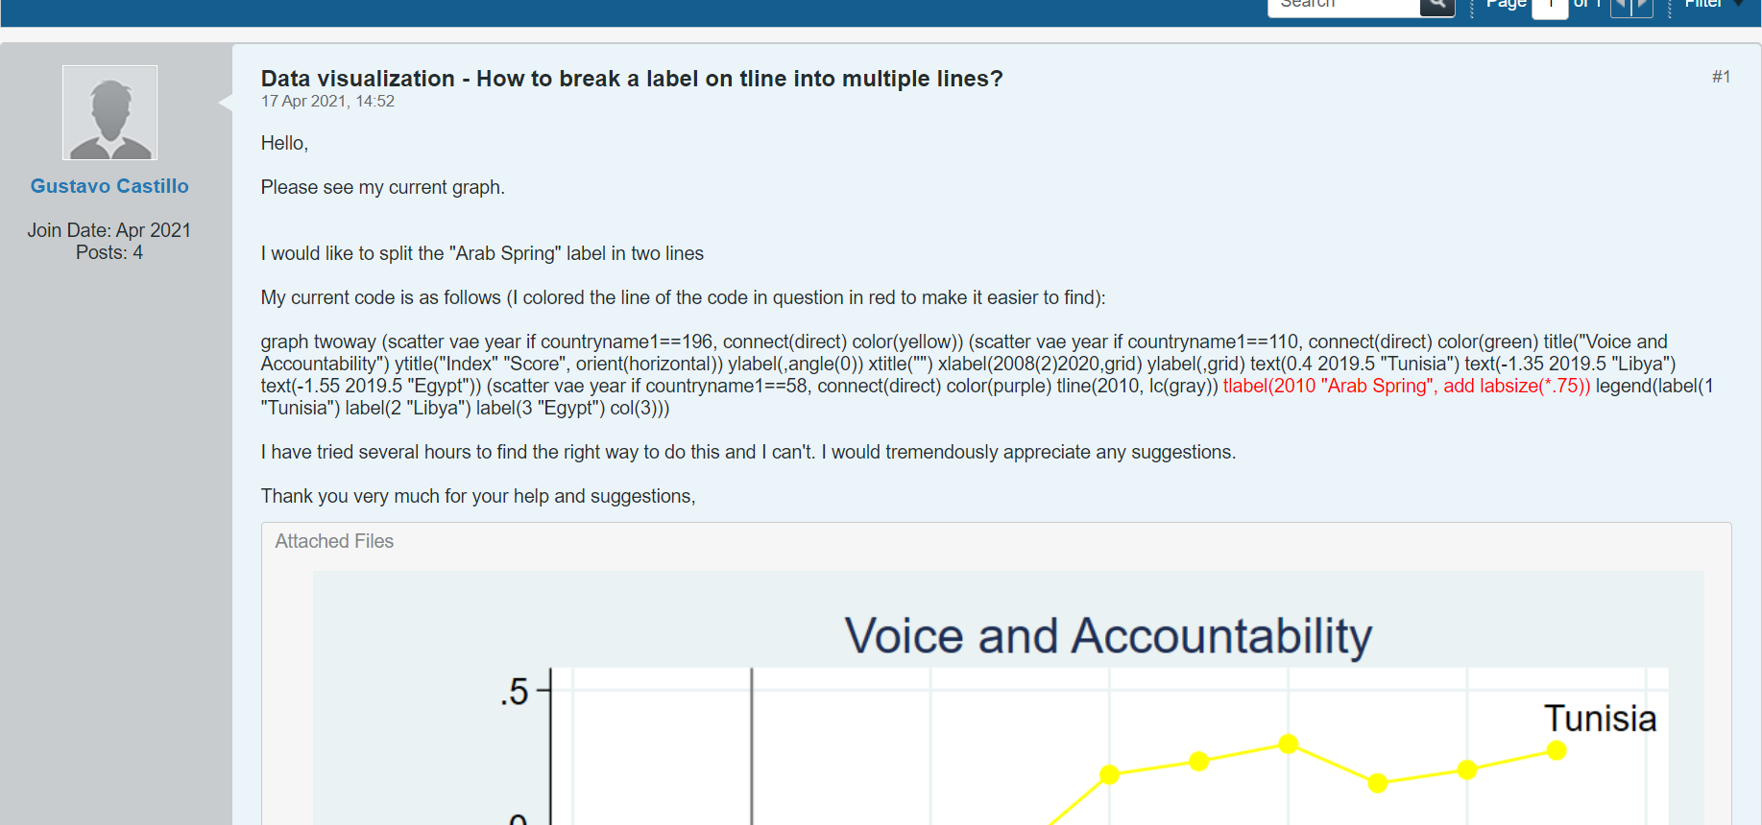
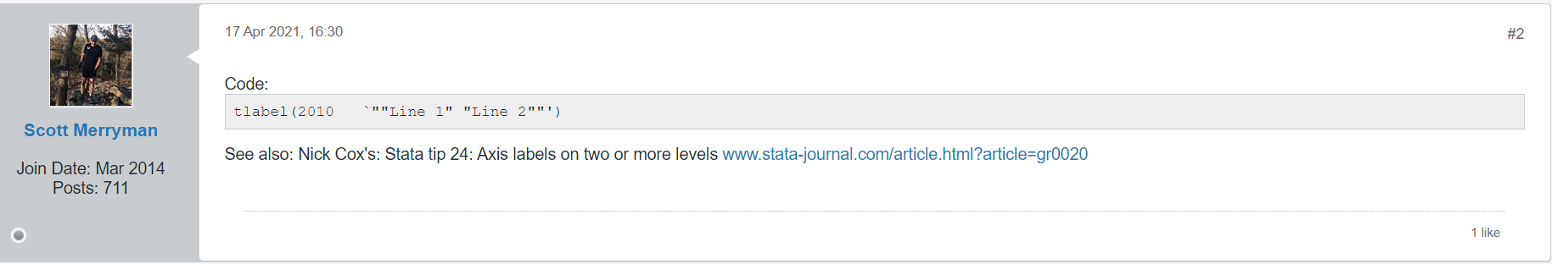
Tip #5 – Ask for help
Notes:
This is just going to be an induction to our TPM reports for new people – we want to get your input.
We want to have your experiences captured so that we can give this to new people who are trying to write these reports.
“We won’t have time to do week-long revisions, and if you want to do anything besides TPM, we need to get this down to a point where we don’t spend so much time on them“ – Shoot for 3 days. The edits should not be as massive as they have been.

Slide 8
END
Notes:
Things to improve:
People are assuming a lot of knowledge on behalf of the reader – this includes the sub-activity description, but it’s also in the findings. Findings are not tied. Also, why does X matter? It looks like we are just writing directly from the KIIs. Specifically integrate MoVs in delivery effectiveness. There is a lack of analysis.
Inconsistencies in what is written in the sub-activity description and implementation fidelity, for example. “Everything that is in your brain has to be on the paper”.

